Slide 1
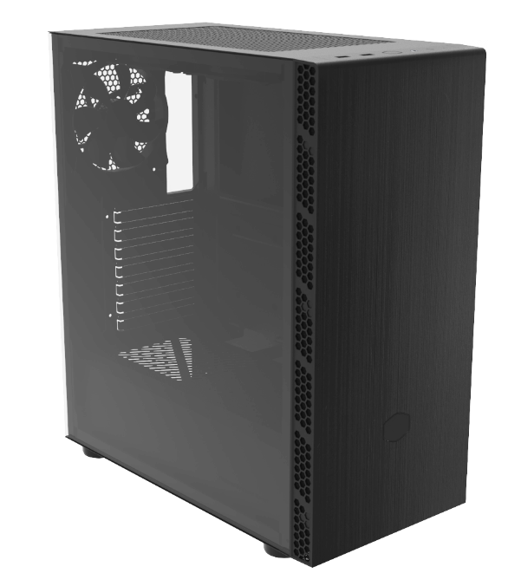
Sensible by design
MasterBox mb600l V2 w/o ODD/ MasterBox mb600l V2 W/ ODD
MB600L2-KGNN-S00 / MB600L2-KNNN-S00 (w/o ODD)
MB600L2-KG5N-S00 / MB600L2-KN5N-S00 (w/ ODD)
Palette & Brush
Each element of the MasterBox MB600L was created from an elegant palette. With a brushed finish, subtle hue, and the minimalistic Cooler Master hexagon, this ATX PC case decorates the gaming setup and workspace while also being able to house the latest hardware.
High style embellishes high upgradeability with front, top, and rear ventilation, offering additional mounting options for upgrading cooling components in the future. If an optional RGB or ARGB fan is installed behind the front panel, the Cooler Master hexagon will also be illuminated on the front panel. A total of 6 fans can be mounted simultaneously, ensuring that even the most demanding builds can stay cool under heavy use.
Variations of the MasterBox MB600L V2 are available with either a tempered glass side panel or steel side panel, and also with the option of including an ODD drive bay.
Product Name |  | MasterBox MB600L V2 w/o ODD |  | MasterBox MB600L V2 w/ ODD
Product Number |  | MB600L2-KGNN-S00 (TG) MB600L2-KNNN-S00 (Steel) |  | MB600L2-KG5N-S00 (TG) MB600L2-KN5N-S00 (Steel)
Exterior Color |  | Black
Materials | Exterior | Steel, Plastic
 | Left Side Panel | Tempered Glass
Dimensions (L x W x H) | Incl. Protrusions | 405.5x204x455.3mm | 460.5x204x455.3mm
 | Excl. Protrusions | 400x204x455.3mm | 455x204x455.3mm
Volume (Liters Excl. Protrusions) |  | 37.15L | 42.26L
Motherboard Support |  | Mini-ITX, Micro-ATX, ATX
Expansion Slots |  | 7
Drive Bays | 5.25“ ODD | 0 |  | 1
 | 2.5” / 3.5” HDD | 2 |  | 2
 | 2.5” SSD | 2 |  | 2
I/O Panel | USB Ports | 2 x USB 3.2 Gen 1 Type A
 | Audio In / Out | 1 x 3.5mm Headset Jack (Audio + Mic)
Pre-installed Fan(s) | Top | N/A
 | Front | N/A
 | Rear | 1 x 120mm
Fan Support | Top | 2 x 120mm, 2 x 140mm |  | 2 x 120mm, 2 x 140mm
 | Front | 3 x 120mm, 2 x 140mm |  | 2 x 120mm, 2 x 140mm , 3 x 120mm(Remove ODD bracket)
 | Rear | 1 x 120mm
Radiator Support | Top | 120/240 (RAM height limit 32mm; install RAM first, then install radiator) |  | 120/240 (RAM height limit 32mm; install RAM first, then install radiator)
 | Front | 120 / 140 / 240 / 280mm |  | 120/140/240/280/360mm (Remove & reinstall ODD bracket to mount 360mm radiator)
 | Rear | 120mm
Clearances | CPU Cooler | 161mm
 | Power Supply | 160mm |  | 180mm
 | Graphics Card | 350mm (w/o front fans & radiator) |  | 400mm (w/o front fans & radiator)
Cable Routing | Behind MB Tray | 18.5mm
Dust Filters |  | Front, Top, Bottom
Power Supply Support |  | Bottom Mount, ATX
Warranty |  | 2 Years
Brushed Front Panel – A brushed finish spans the entire front panel for an elegant and minimalistic design.
Hexagon Gleam – If an optional, illuminated fan is installed, the Cooler Master hexagon logo will capture light from the fan and emit a glow on the front panel.
Mesh Intakes – Large, mesh intakes span each side of the front panel to provide additional airflow to system.
With/Without ODD Support – Depending on preference, an ODD version of the chassis is available. If an ODD is not preferred, cleaner appearance and more cooling options on the top and front panels are supported. The ODD version of the MB600L is slightly deeper in comparison to its non-ODD counterpart.
Versatile Cooling Options – Support for up to six fans and front, top, and rear radiator support ensure that performance is not compromised.
Breathable Power Supply Shroud – The PSU cover is ventilated on top of the power supply location, this allows actively cooled units to be installed either with the fan facing the top or bottom, also with the possibility of installing passively cooled power supplies.
Room For Upgrades* - Support for up to a 400mm graphics card, a 161mm CPU cooler, and multiple fan/radiator locations provide room for upgrades to stay ahead of the game.
*clearances vary per model
Removable HDD Cage – The modular frame allows builders to remove the drive cage completely, providing a greater freedom in building and increased compatibility for long power supplies.
EAN code | MB600L2-KGNN-S00 (4719512117392) MB600L2-KNNN-S00 (4719512117408) MB600L2-KG5N-S00 (4719512117378) MB600L2-KN5N-S00 (4719512117385)
UPC code | MB600L2-KGNN-S00 (884102089701) MB600L2-KNNN-S00 (884102089718) MB600L2-KG5N-S00 (884102089688) MB600L2-KN5N-S00 (884102089695)
Net weight (KG) | MB600L2-KGNN-S00 (5.53), MB600L2-KNNN-S00 (4.58) MB600L2-KG5N-S00 (6.24), MB600L2-KN5N-S00 (5.20)
Gross weight (KG) | MB600L2-KGNN-S00 (6.61), MB600L2-KNNN-S00 (5.66) MB600L2-KG5N-S00 (7.41), MB600L2-KN5N-S00 (6.37)
Carton dimension (L x W x H) | MB600L2-KGNN-S00 (507 x 272 x 480) MB600L2-KNNN-S00 (507 x 272 x 480) MB600L2-KG5N-S00 (507 x 272 x 532) MB600L2-KN5N-S00 (507 x 272 x 532)
 | MB600L2-KGNN-S00 MB600L2-KNNN-S00 |  |  | MB600L2-KG5N-S00 MB600L2-KN5N-S00
Cont. | W/ Pallet | Carton/ Pallet | W/O Pallet | W/ Pallet | Carton/ Pallet | W/O Pallet
20’ | 320 | 40 | 435 | 320 | 40 | 388
40’ | 720 | 40 | 940 | 720 | 40 | 838
40 HQ | 900 | 50 | 1085 | 792 | 44 | 984

Slide 2
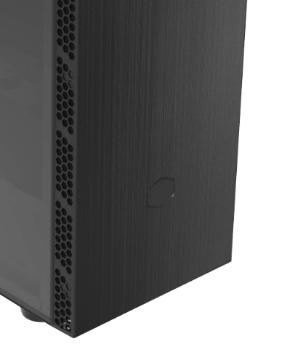
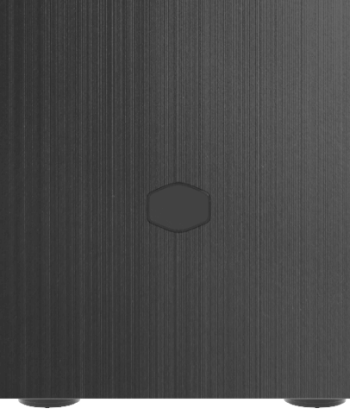
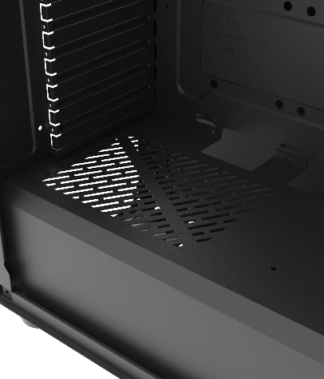
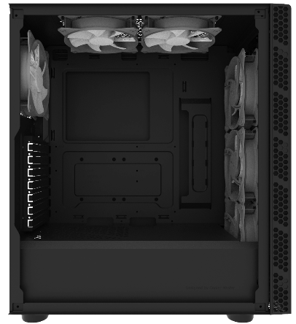
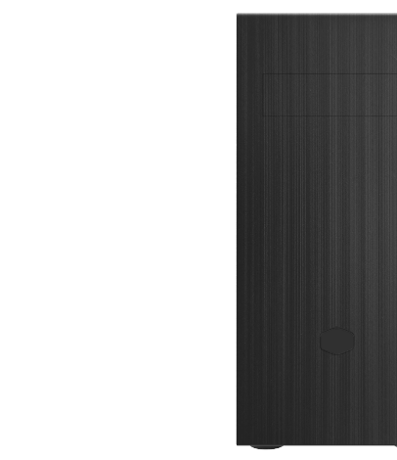
MasterBox mb600l
Brushed Front Panel
Hexagon Gleam
Mesh Intakes
A brushed finish spans the entire front panel for an elegant and minimalistic design.
The Cooler Master hexagon on the front panel relays light from optional, illuminated fans. If an optional RGB or ARGB fan is installed behind the front panel, the hexagon will capture light from the fan and emit a glow on the front panel.
Large, mesh intakes span each side of the front panel to provide additional airflow to system.
Breathable Power Supply Shroud
Versatile Cooling Options
With/Without ODD Support
The PSU cover is ventilated on top of the power supply location, this allows actively cooled units to be installed either with the fan facing the top or bottom, with the possibility to install passively cooled power supplies.
Support for up to six fans and front, top, and rear radiator support ensure that performance is not compromised.
Depending on preference, an ODD version of the chassis is available. If an ODD is not preferred, a cleaner appearance and more cooling options on the top and front panels are supported. The ODD version of the MB600L is slightly deeper in comparison to its non-ODD counterpart.

